Slide 1
Team members
Sandeep Mandala - 700748408
Manasa Yemula - 700762091
Nitesh kumar Pondugula - 700763258
Bhanu Prakash Nimmagadda - 700756164
Heart Attack Prediction System

Slide 2
CONTENTS
Introduction
Problem Statement and Objective
Proposed Method
Solution and Approach
Technology Stack
Proto type
Advantage
Limitations
Conclusion

Slide 3
INTRODUCTION
Heart attack prediction is the process of utilizing machine learning techniques to foresee the likelihood of a heart attack based on various health parameters.
This is crucial in the medical field as it can save lives by predicting potential heart problems before they occur.
The system integrates Python, Tkinter for the GUI, and MySQL for database management, providing an efficient and user-friendly tool for medical professionals.

Slide 4
Problem Statement and Objective
Problem Statement
Rising heart attack rates
Limited precision on Traditional methods
Underutilization of available data
Delayed diagnosis

Slide 5
OBJECTIVE
Enable Early Detection: Identify high-risk individuals before a heart attack occurs, allowing for timely medical intervention.
Improve Predictive Accuracy: Use machine learning models to analyze complex datasets for more precise, personalized risk assessments.
Support Preventive Care: Encourage lifestyle modifications and preventive measures based on real-time risk predictions.
Integrate Real-Time Monitoring: Utilize data from wearable devices and electronic health records for continuous, up-to-date risk evaluation.
Enhance Healthcare Decision-Making: Provide healthcare professionals with a reliable tool to aid in diagnosing and managing heart disease.
Increase Patient Awareness: Empower individuals to monitor and understand their heart attack risk, promoting proactive heart health management

Slide 6
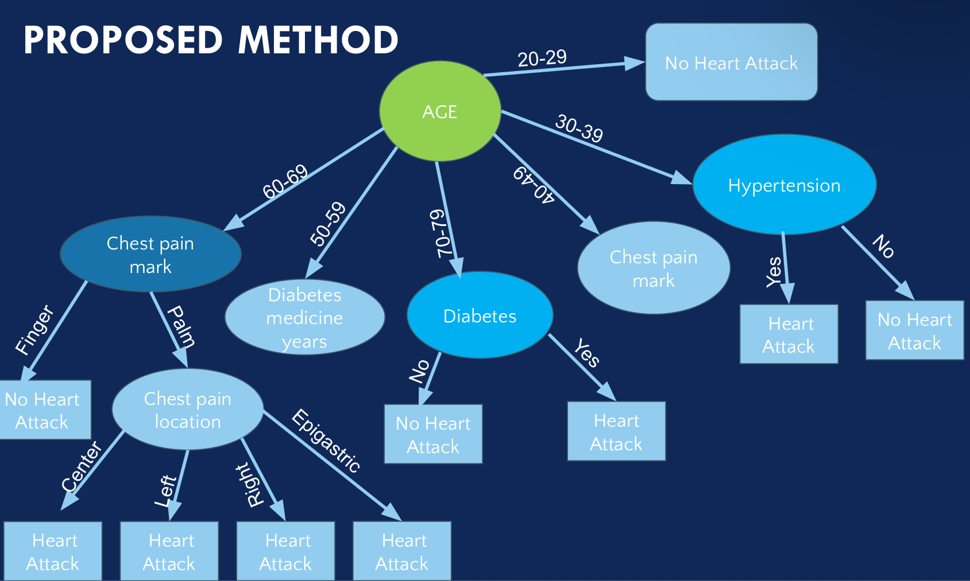

Slide 7
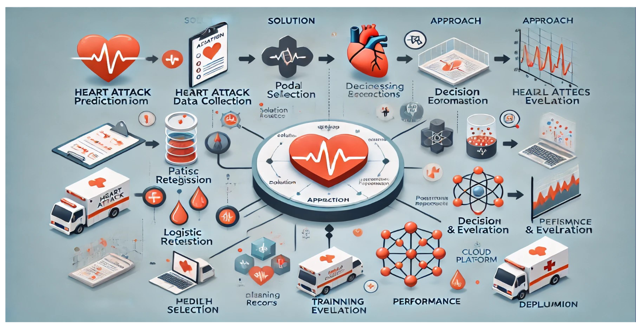
Solution & Approach

Slide 8



PROJECT MODULES
Datetime,Matplotlib,Numpy,Pandas,Sklearn ,Logistic Regression

Slide 9
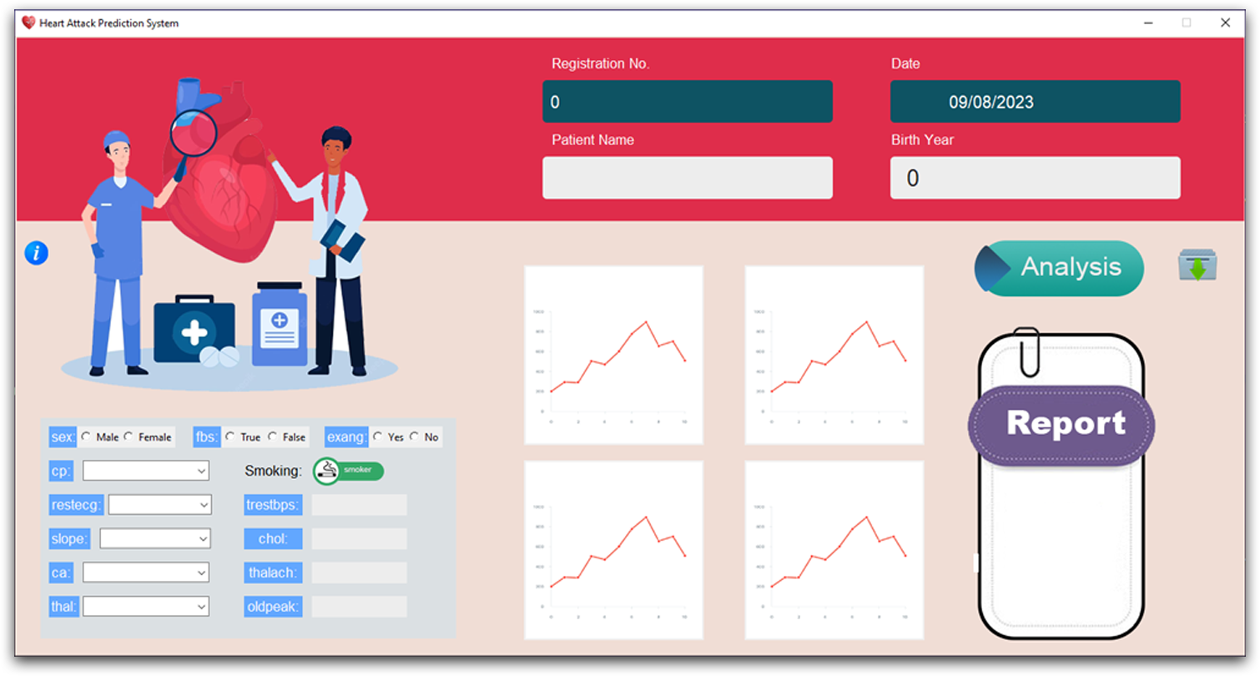
PROTOTYPE

Slide 10
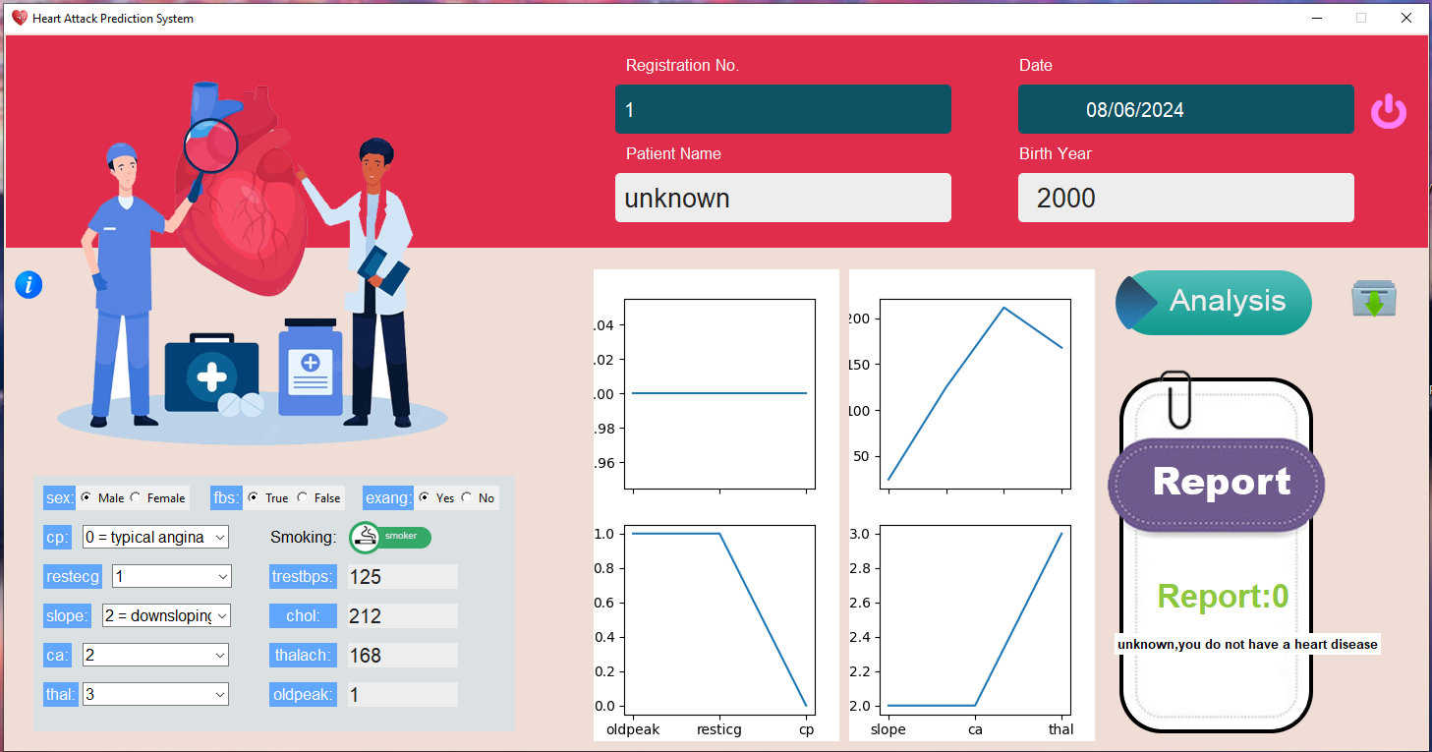
PROTOTYPE WITH RESULT

Slide 11
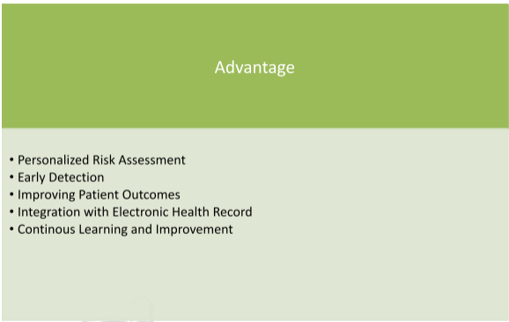

Slide 12
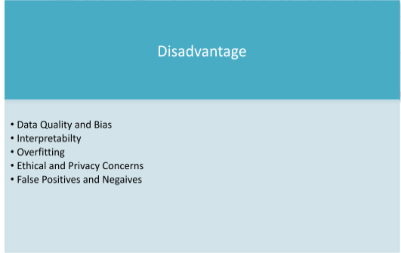

Slide 13
Conclusion
Data Collection & Storage: Secure and scalable databases are essential for storing health data.
Machine Learning Models: Advanced algorithms and frameworks like Scikit-learn, TensorFlow, and PyTorch are critical for building accurate predictive models.
Preprocessing & Feature Engineering: Effective data cleaning and transformation, using tools like Pandas, ensures high-quality inputs.
Visualization & Frontend: Dashboards and user interfaces enable medical professionals to access predictions easily.
Cloud, DevOps & Deployment: Ensuring scalability, security, and continuous integration is crucial for the system's reliability and compliance with healthcare standards (e.g., HIPAA).
Monitoring & Feedback: Constant model evaluation and performance monitoring ensure the system's long-term effectiveness and improvement

Slide 14
THANK YOU

